Slide 1

Chapter 3:
Pattern Discovery in Data Mining
Notes:
‹#›

Slide 2
FPGrowth - A Pattern Growth Approach
Objective
Introduction to the FPGrowth algorithm for frequent pattern mining
How FPGrowth utilizes a tree-based data structure (FP-tree) for efficient pattern discovery
Comparison of FPGrowth with the Apriori algorithm
‹#›

Slide 3
FPGrowth - A Pattern Growth Approach
Introduction to FPGrowth
FPGrowth is a popular algorithm for mining frequent patterns in transactional datasets.
It adopts a pattern growth strategy, which avoids the need for candidate generation like the Apriori algorithm.
FPGrowth uses a compact data structure called an FP-tree for efficient pattern discovery.
‹#›

Slide 4
FPGrowth - A Pattern Growth Approach
FP-Tree: Compact Data Structure
The FP-tree (Frequent Pattern tree) is a compact and efficient data structure used by FPGrowth.
It represents the transactional dataset in a tree-like structure that captures itemset relationships.
‹#›

Slide 5
FPGrowth - A Pattern Growth Approach
Building the FP-Tree
Step 1: Constructing the Header Table
  Scan the dataset to count the support of each item and build a header table.
  The header table stores item support counts and pointers to the nodes in the FP-tree.
Step 2: Building the FP-Tree
  Scan the dataset again, processing transactions one by one.
  For each transaction, add items to the FP-tree while maintaining the item order and support count.
‹#›

Slide 6
FPGrowth - A Pattern Growth Approach
Mining Frequent Patterns with FPGrowth
Recursive Mining:
  Perform a depth-first traversal of the FP-tree to mine frequent patterns.
  Each path in the FP-tree represents a frequent pattern.
Conditional Pattern Base and Conditional FP-Tree:
  Extract conditional pattern bases for each frequent item in the FP-tree.
  Construct a conditional FP-tree for each frequent item using its corresponding conditional pattern base.
Recursive Tree Growth:
  Recursively apply the FPGrowth algorithm to each conditional FP-tree.
  Generate frequent patterns by appending the frequent item to each path in the conditional FP-tree.
‹#›

Slide 7
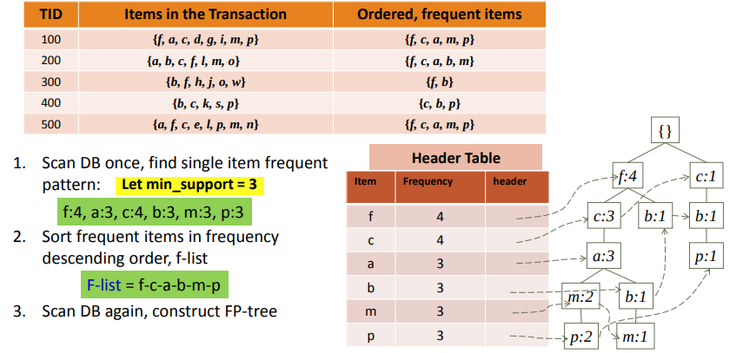
FPGrowth - A Pattern Growth Approach
Example: Construct FP-tree from a Transational DB
‹#›

Slide 8
FPGrowth - A Pattern Growth Approach
Advantages of FPGrowth
Efficient Pattern Mining:
  FPGrowth eliminates the need for candidate generation, reducing computational overhead.
  It leverages the FP-tree structure to expedite frequent pattern discovery.
Handling High-Dimensional Data:
  FPGrowth efficiently handles datasets with a large number of items and high-dimensional itemsets.
  It is particularly effective for mining complex patterns in such datasets.
‹#›

Slide 9
FPGrowth - A Pattern Growth Approach
Comparison with Apriori
FPGrowth vs. Apriori:
  FPGrowth does not generate candidate itemsets, unlike the Apriori algorithm.
  It uses the FP-tree structure, whereas Apriori uses an itemset lattice.
  FPGrowth often outperforms Apriori in terms of efficiency and scalability.
‹#›

Slide 10
FPGrowth - A Pattern Growth Approach
Applications and Use Cases
FPGrowth has various applications, including:
  Market basket analysis for identifying frequently co-occurring items.
  DNA sequence analysis in bioinformatics.
  Intrusion detection in cybersecurity.
  Recommender systems for personalized recommendations.
‹#›

Slide 11
Summary
FP-Growth Algorithm
FP-Growth: Efficient frequent itemset mining.
Steps: Build FP-tree, mine itemsets recursively.
Advantages: Reduced scans, suited for large data.
Consideration: Memory usage varies.
‹#›

